Slide 1
District Assembly
Club Secretaries

Slide 8
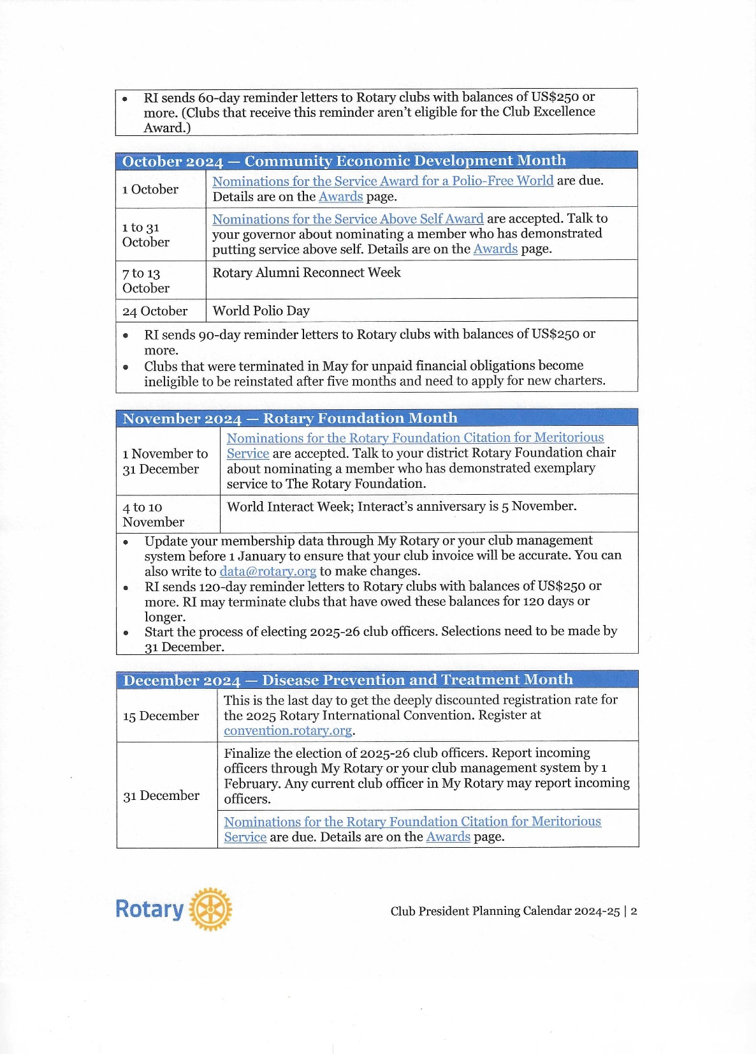

Slide 9
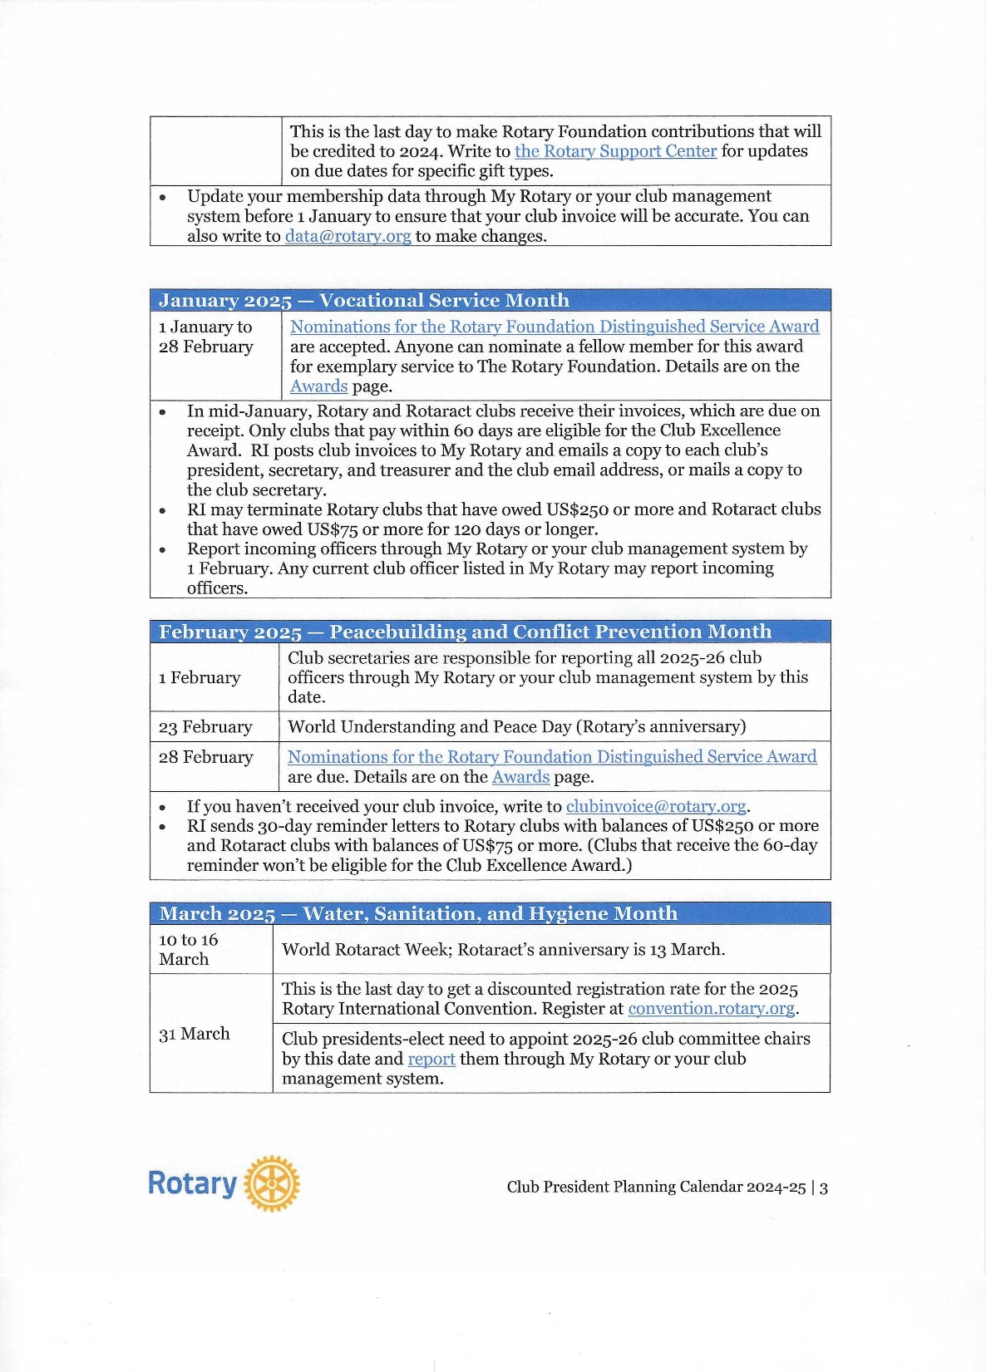

Slide 10
